Slide 1

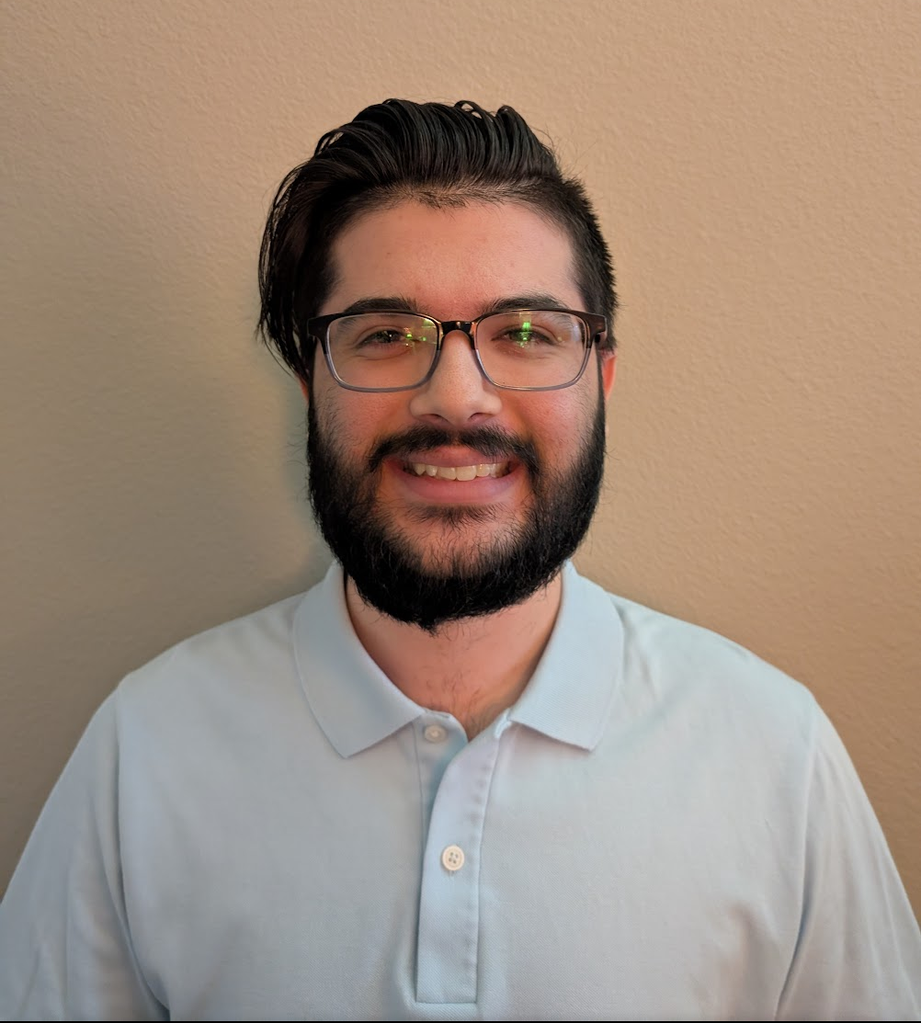

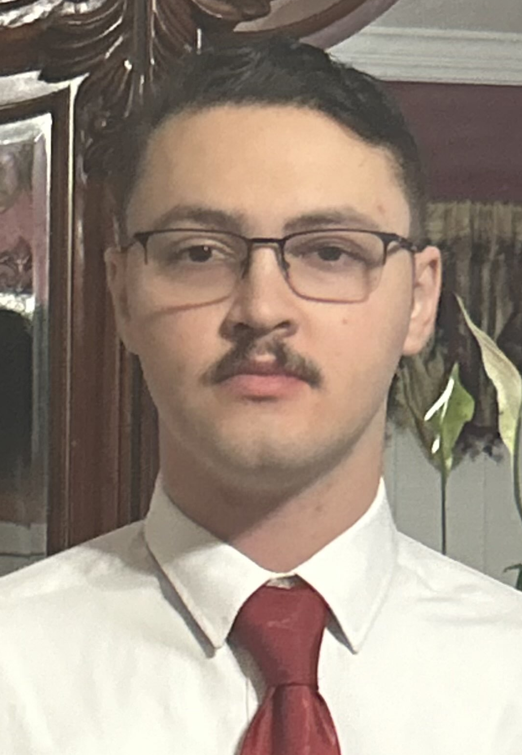
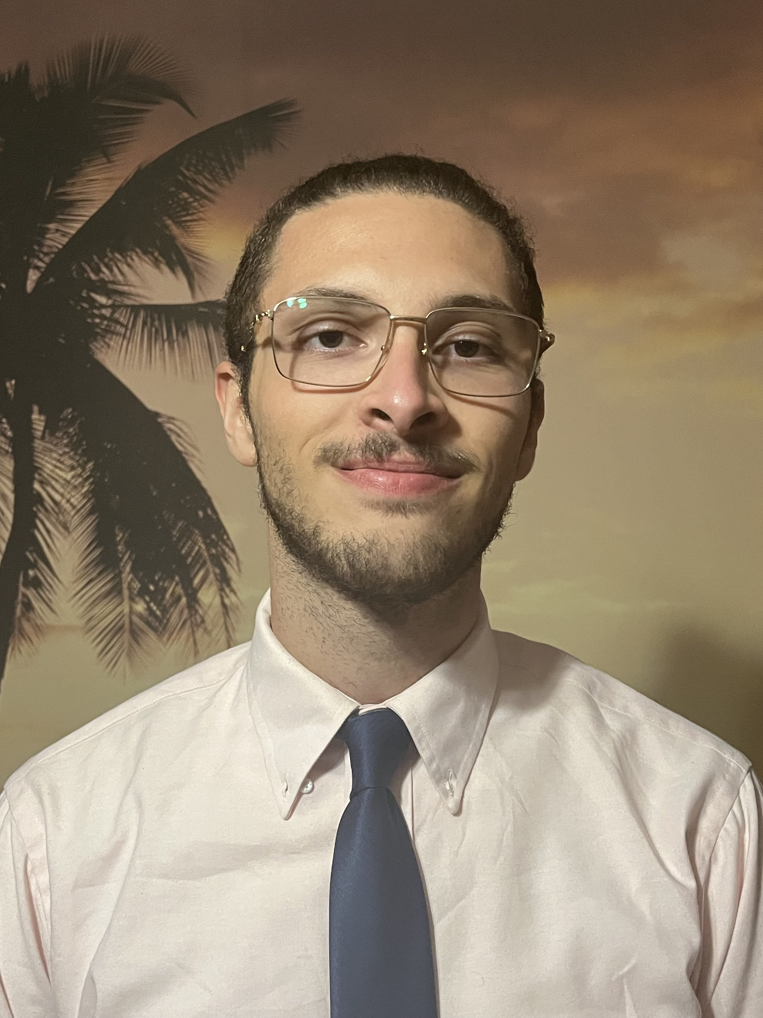

S.W.A.N-U.S.A
Smart Water Bottle with Nutritional Concentration Measurements
Group 10:
Gonzalo
Gomez –Silva (EE)
Dominic Falvo (EE)
Farris Thrower (PSE)
Rhami Thrower (CS)

Slide 2
Engineering Specifications
Product Requirements | Required specification
Battery life needs to be reliable | ≥ 3 Hours
Weight of bottle should be easy to handle | ≤ 2 Pounds
Bluetooth to app time should be smooth | ≤ 50 milliseconds
Elapsed time for information to update | < 5 seconds
Power efficiency of all components should support battery life | ≥ 80 % efficient
Accurately determine reducing sugar concentration in beverage | ≥ 80% accurate
Accurate ultrasonic sensor reading for beverage level | ≥ 80% accurate
High signal to noise ratio for adequate optical signal | SNR ≥ 40 dB

Slide 3
Test Procedure for Water Level Sensing
We are going to test six different water levels. We are going to demo three tests!
Full (at 38 oz) -100%
Half (at 19 oz) – 50%
Empty (0 oz) – 0%
We will also measure the water level with a ruler to ensure the accuracy is above 80%.

Slide 4
Test Results for Water Level
Water Level Sensor Testing
Water Level | Oz | Percent full (Ruler (cm)) | Percent full (Sensor(cm)) | Accuracy
Full | 38 | 6.1 | 7 | 87%
Half | 19 | 11.1 | 11.3 | 98%
Less than half | 6 | 13.6 | 14 | 97%
Empty | 0 | 16.1 | 15.7 | 97%

Slide 5

Test Procedures for SNR
Measure ambient lighting.
Measure ambient and LED lighting at the same time.
Use the following formula to calculate SNR in dBs:
$SNR=−20 x log\left(\frac{Ambient}{Ambient+Intensity}\right)$

Slide 6

Test Results for SNR
SNR Testing
Trial # | Reading (dB)
1 | 70.39
2 | 70.4
3 | 70.4
4 | 78.1
5 | 78.1
6 | 70.39
7 | 70.4
8 | 70.41
9 | 70.4
10 | 70.4
Test results show we are getting double the SNR as anticipated.
When the lid is on, we get SNR readings of 170 or more
${SNR}_{theoretical}=−20\log{\frac{4.98µW}{2mW}=52dB}$

Slide 7

Test Procedure for Sugar Concentration
Measure 5 iterations of LEDs intensity and take the average
Measure 5 iterations of transmitted power through the sample and take the average
Calculate Absorption based on those readings.
Use Beer’s law to calculate Concentration in mol/l and convert to g/ml
$A=−log\left(\frac{Transmitted}{Intensity}\right)$
$C(\frac{g}{ml})= \left(\frac{A}{εb}\right)\left(\frac{dilution factor x Molar Mass}{1000 }\right)$

Slide 8

Test Results for sugar testing
Actual vs. Measured Sugar Concentration
Beverage | Sugar (g/ml) | Measured sugar (g/ml) | accuracy
Red bull | 0.107 | 0.043 | 40.55%
Monster | 0.114 | 0.1311 | 98.4%
Rockstar | 0.1313 | 0.1096 | 96.0%
Arizona | 0.065 | 0.073 | 85.76%
Calculated epsilon based on calibration curve
$$ε=\left(\frac{A}{cb}\right)=83 {mol}^{−1}{cm}^{−1}$$
The b is the cuvette length of 1 cm and A is the
measured absorption. We ran the calculation at
each known concentration and took the average

Slide 9
Software Testing
UI
  Home page
    Element dynamically update to fit string
    Home page elements can be interacted w/ and complete their functions(logout)
  Login/Register pages
    Elements can be interacted w/ and complete their functions
    Redirects happen appropriately.
  Bluetooth UI
    Displays all valid Bluetooth devices and shows the connected device.
    User can Interact with the elements, and they do their function properly.
Back-end
  User authentication
    Provided proper credential user can connect, and establish a session
  User account creation
    Provided proper inputs (username, password, email) user can create account and verify account creation
Bluetooth
  Device connection
    User can connect with proper esp32 device and maintain connection
  Device communication
    Device can communicate Strings in Json format

Slide 10
Software Testing results
UI
  User can Interact with all elements, and they complete their functions
  Home Page does update dynamically but only after a change event occurs (rotation of screen or user input)
Login/register UI
  Elements work as intended permitting user to login and register accounts.
Bluetooth UI
  User is able to select devices, and it shows that its connected, but it doesn't retain this when page is changed.

Slide 11

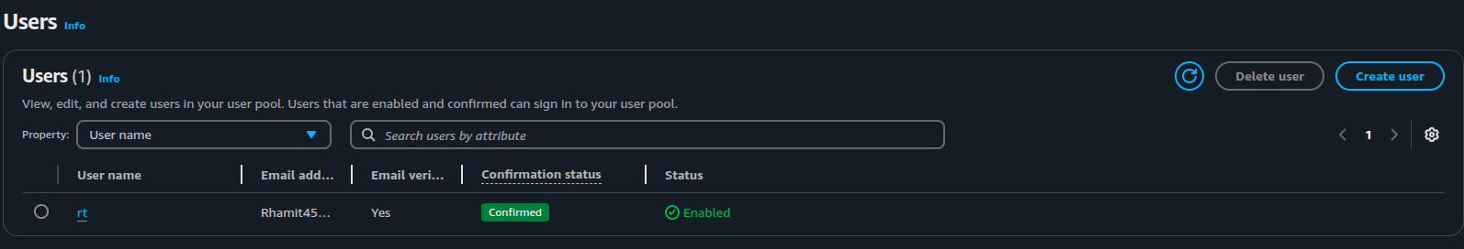
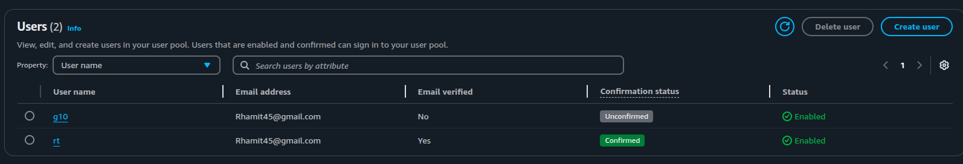
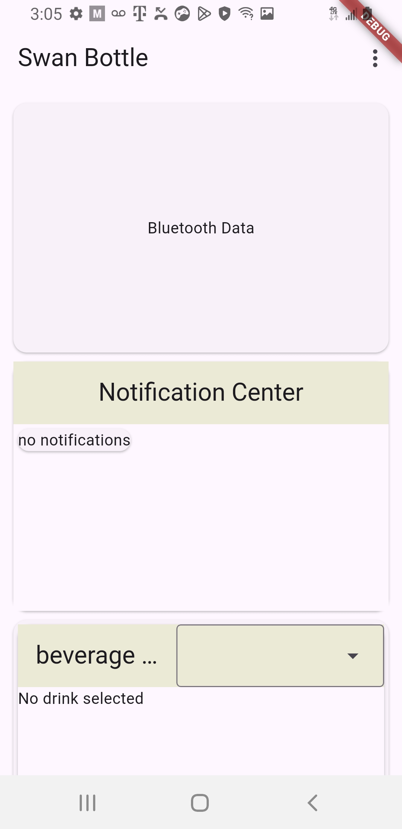
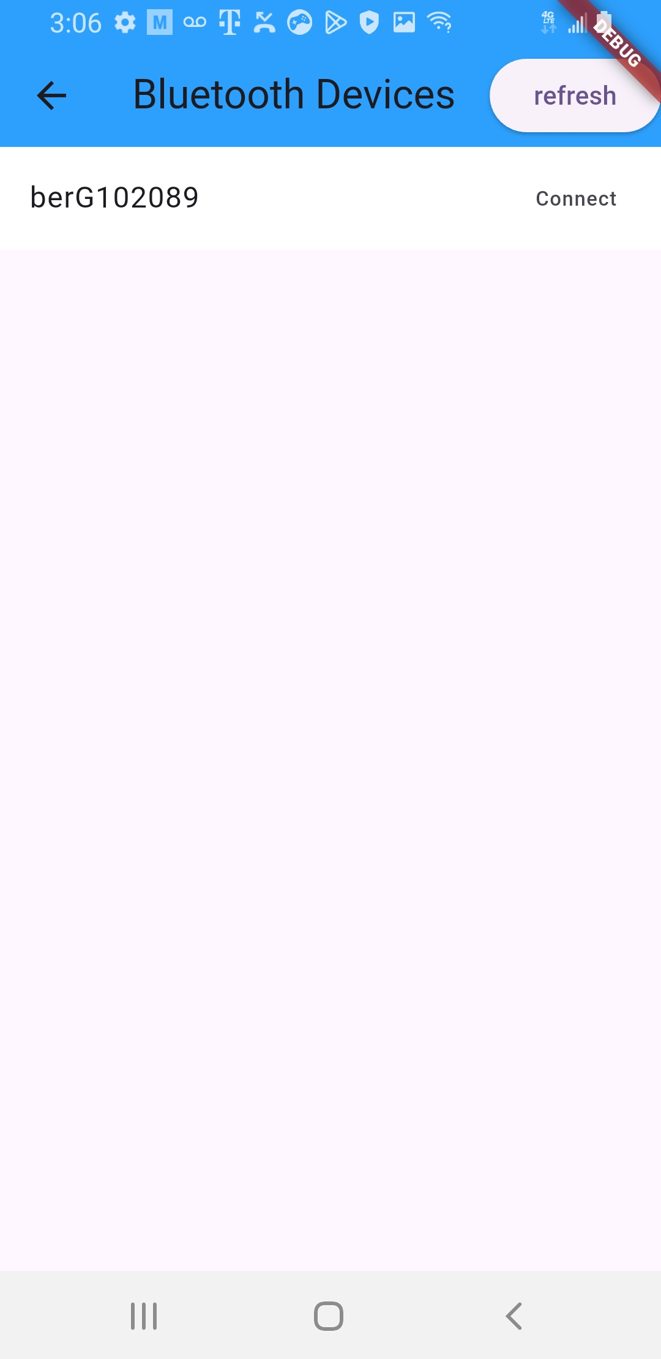
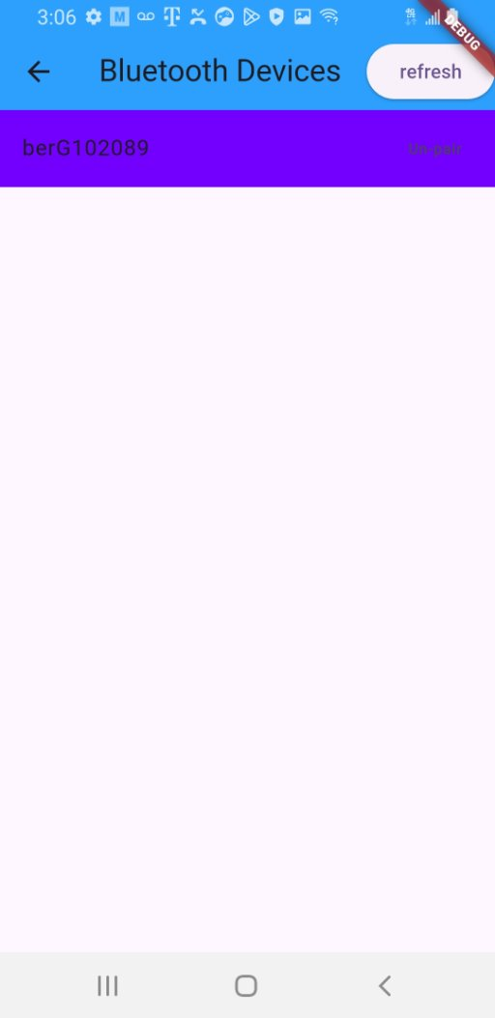
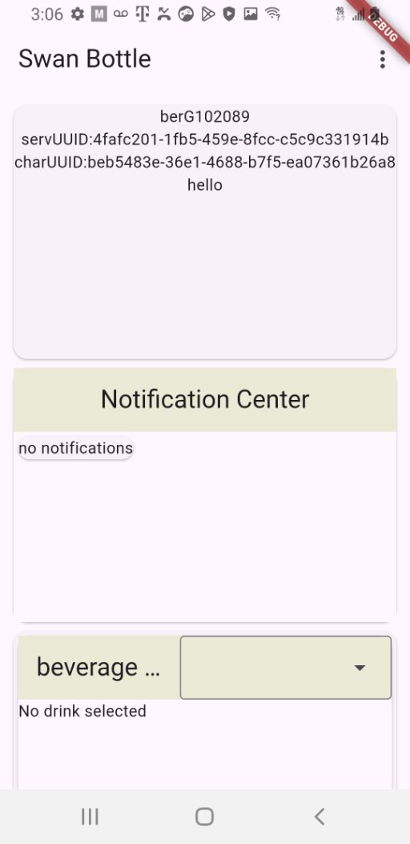
Software testing results continued...
Back-end
  User can provide proper credentials to either login or create account (please refer to demo video to see some results and to the figures to see created user and user in creation)
Bluetooth
  User is able to connect with proper esp32 device.(please refer to figures for results)
  Data communication works perfectly

